Slide 1
Professional JavaScript for
Web Development
Chapter-6 :Object-Oriented Programming
PRESENTED BY:
DAW SAW THANDAR SHWE
LECTURER
ITSM DEPARTMENT
UNIVERSITY OF COMPUTER STUDIES (SITTWAY)
Information Technology Supporting and Maintenance

Slide 2
Outlines
Factory Pattern
Constructor Pattern
Prototype Pattern
Combination Constructor/Prototype Pattern
Dynamic Prototype
Parastic Constructor Pattern
Durable Constructor Pattern
Information Technology Supporting and Maintenance

Slide 3
Factory Pattern
function createPerson(name, age, job){
var o = new Object();
o.name = name;
o.age = age;
o.job = job;
o.sayName = function(){ alert(this.name); };
return o; }
var person1 = createPerson("Nicholas", 29, "Software Engineer");
var person2 = createPerson("Greg", 27, "Doctor");
person1.sayName(); //"Nicholas"
person2.sayName(); //"Greg"
Information Technology Supporting and Maintenance

Slide 4
Constructor Pattern
function Person(name, age, job){
this.name=name;
this.age = age;
this.job = job;
this.sayName = function(){
alert(this.name); };
}
var person1 = new Person("Nicholas", 29, "Software Engineer");
var person2 = new Person("Greg", 27, "Doctor");
person1.sayName(); //"Nicholas"
person2.sayName(); //"Greg"
Information Technology Supporting and Maintenance

Slide 5
Prototype Pattern
function Person( ){
}
Person.prototype.name=“Nicholas”;
Person.prototype.age=29;
Person.prototype.job=“Software Engineer”;
Person.prorotype.sayName = function(){ alert(this.name); };
var person1 = new Person( );
person1.sayName(); //"Nicholas"
var person2 = new Person( );
person2.sayName(); //"Nicholas"
alert(person1.sayName==person2.sayName); //true
Information Technology Supporting and Maintenance

Slide 6
Combination Constructor/Prototype Pattern
function Person(name, age, job){
this.name=name;
this.age = age;
this.job = job; }
Person.prorotype = function(){
constructor: Person,
sayName: function( ){alert(this.name); };
};
var person1 = new Person("Nicholas", 29, "Software Engineer");
var person2 = new Person("Greg", 27, "Doctor");
person1.sayName(); //"Nicholas"
person2.sayName(); //"Greg"
Information Technology Supporting and Maintenance

Slide 7
Dynamic Prototype Pattern
function Person(name, age, job){
this.name=name;
this.age = age;
this.job = job;
Person.prorotype.sayName = function(){
alert(this.name); };
}
var person1 = new Person("Nicholas", 29, "Software Engineer");
var person2 = new Person("Greg", 27, "Doctor");
person1.sayName(); //"Nicholas"
person2.sayName(); //"Greg"
Information Technology Supporting and Maintenance

Slide 8
Parastic Constructor Pattern
function Person(name, age, job){
var o = new Object();
o.name = name;
o.age = age;
o.job = job;
o.sayName = function(){alert(this.name); };
return o; }
var friend = new Person("Nicholas", 29, "Software Engineer");
friend.sayName(); //"Nicholas"
Information Technology Supporting and Maintenance

Slide 9
Durable Constructor Pattern
similar to the parasitic constructor pattern
Information Technology Supporting and Maintenance

Slide 10
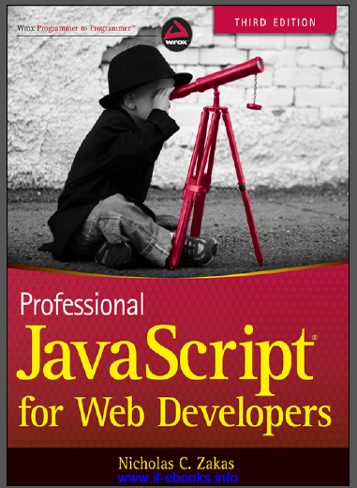
References
“PROFESSIONAL JavaScript for web Developers”
Third Edition
Zichalos C.Zakas
Nicholas, “Professional JavaScript for Web Development”
Colleen van Lent Ph.D, “INTERACTIVITY WITH JAVASCRIPT”

Slide 11
Thank You
1

